Slide 1
Parametric Analysis using Ansys Fluent Version: 2024R1

Slide 2
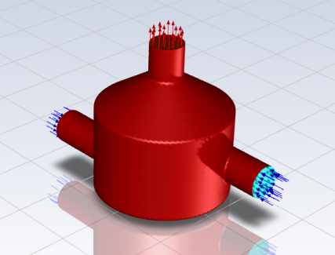
Introduction
“Parametric analysis allows you to explore the effects of varying design parameters on your simulation results. This type of analysis is particularly useful for optimizing designs and understanding the sensitivity of your model to different inputs.”
This tutorial illustrates how to perform a parametric study of a static mixer simulation within Ansys Fluent. The analysis will take an existing Fluent case file with predefined input and output parameters, and setup and solve various permutations that analyze a few changes to the parametric variables, all within the Fluent interface.

Slide 3
Introduction
This tutorial demonstrates how to do the following:
• Start with a Fluent case and data file with input and output parameters.
• Define a series of additional cases (design points) where each represents a change to one or more the parameters.
• Update the series of design points.
• Generate a simulation report for each design point.
• Review the simulation reports and perform a comparison of the results between design points.

Slide 4
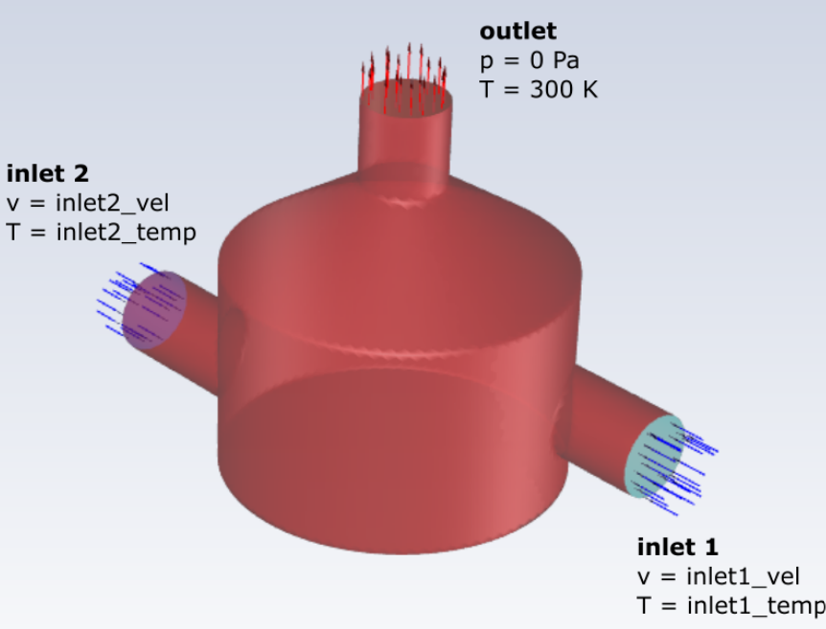
Problem Description
The problem involves a static mixture with two inlets and one output. Fluid enters through two inlets using conditions described by separate input parameter expressions for the fluid velocity magnitude (inlet1_vel and inlet2_vel) and temperature (inlet1_temp and inlet2_temp). The fluid exits the outlet of the mixer based on a pressure outlet condition with a temperature of 300 Kelvin.
Input Value | Parameter
inlet1_vel | 5 m/s
inlet1_temp | 300 K
inlet2_vel | 10 m/s
inlet2_temp | 350 K

Slide 5
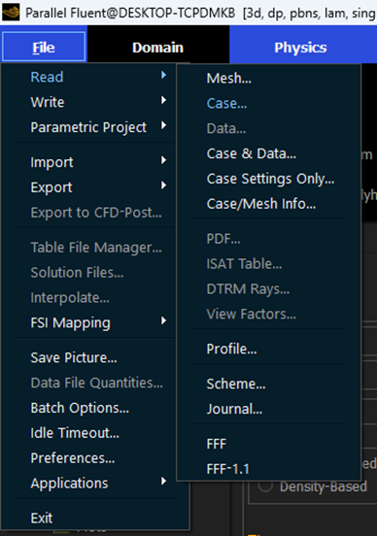
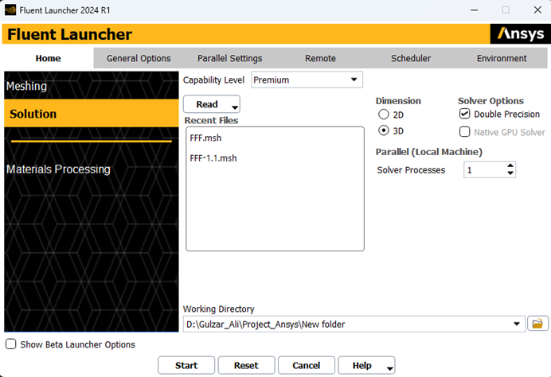
Setting up Simulation Environment
Download the case & data files for static_mixture
Read the case & data files using ansys Fluent
Top left corner of fluent window. Read the case file provided with this tutorial.

Slide 6
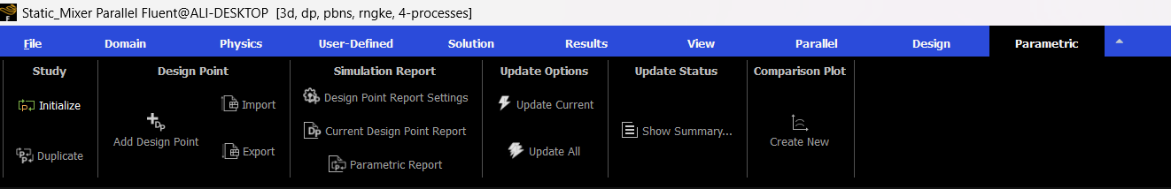
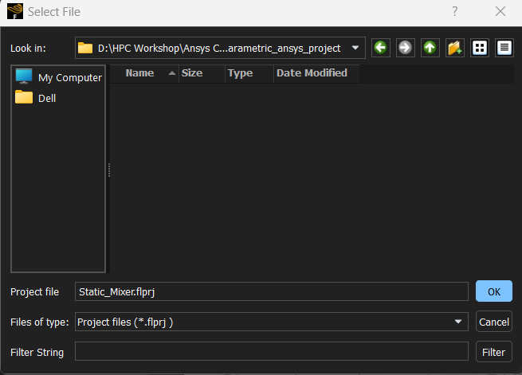
Initializing Parametric Study
Initialize the study by creating a project file.

Slide 7
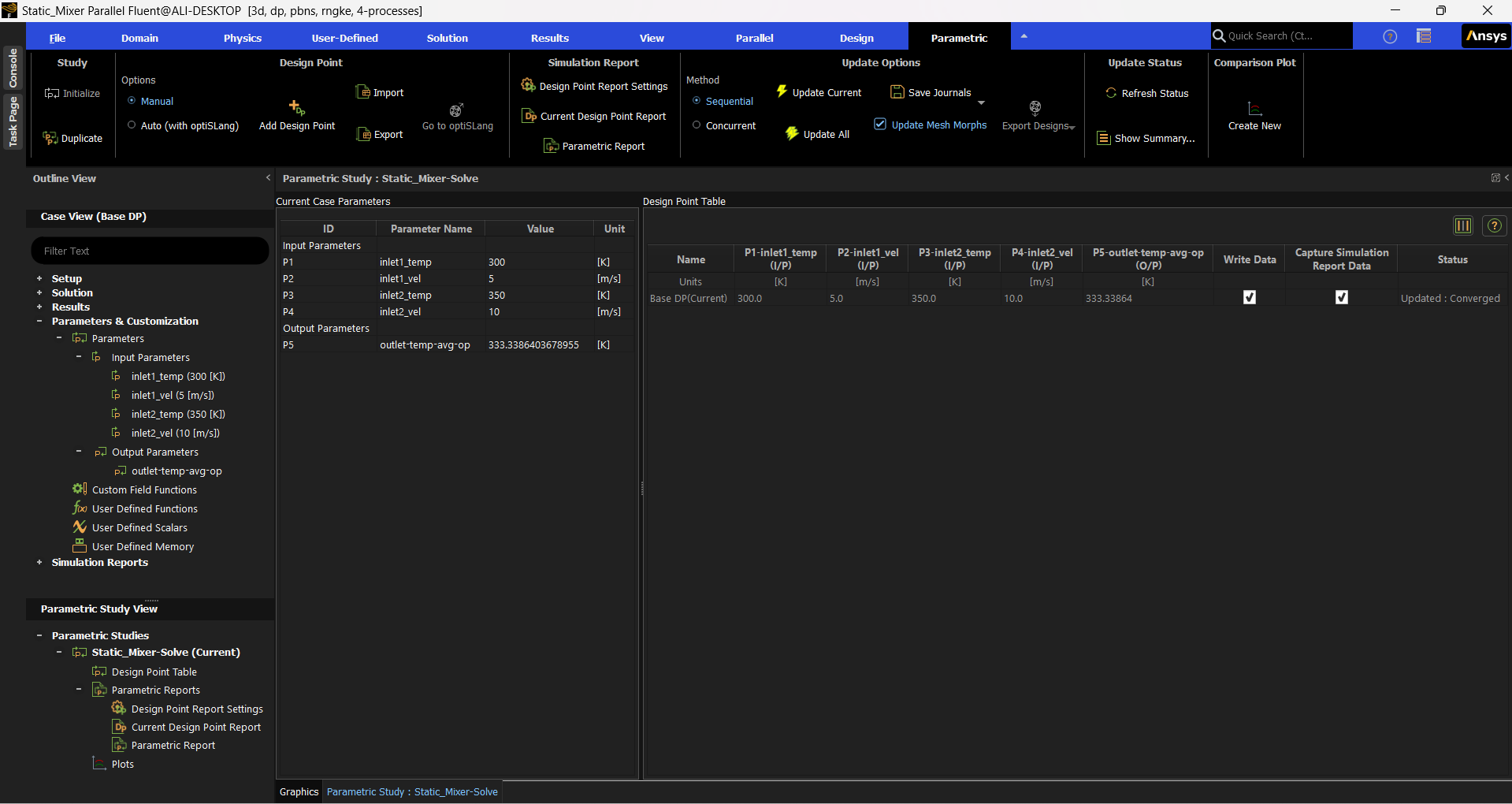
Initializing Parametric Study
Parametric Ribbon
Case View
Design Point Table
Review the Current Case Parameters
Parametric Study View

Slide 8
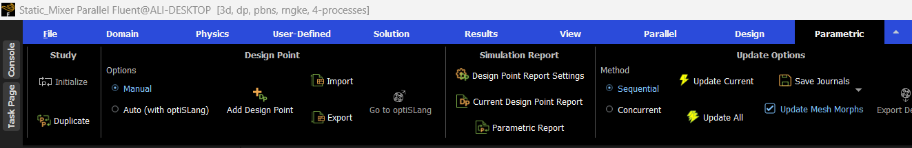
Adding Design Points
In this tutorial, you will only vary the velocity at one of the two inlets, gradually increasing the value to match the velocity at the other inlet.
Design Point | P2-inlet1_vel | Enable Write Data
DP1 | 6 m/s | yes
DP2 | 7 m/s | yes
DP3 | 8 m/s | yes
DP4 | 9 m/s | yes
DP5 | 10 m/s | yes

Slide 9
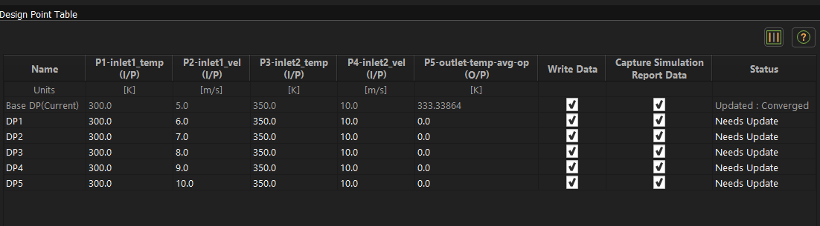
Adding Design Points

Slide 10
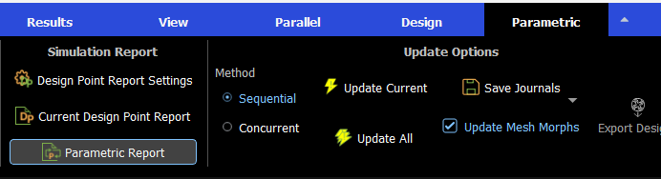
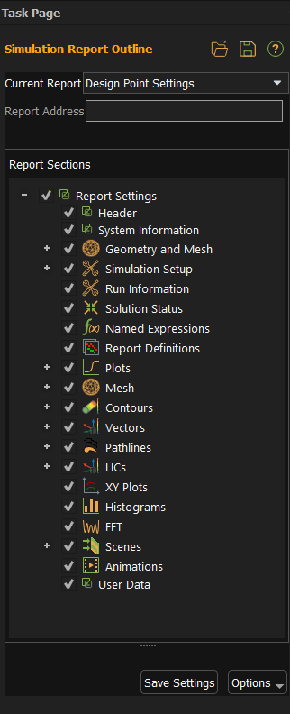
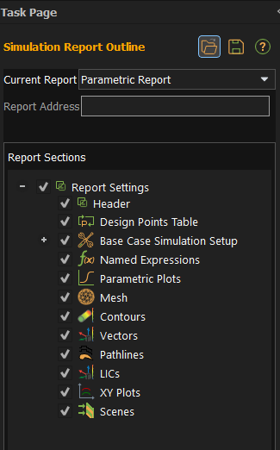
Setup Design Point and Parametric Report
you can choose to include or exclude various portions of a typical simulation report

Slide 11
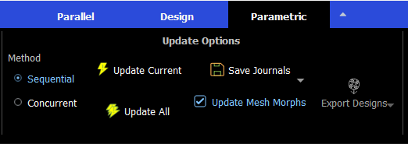
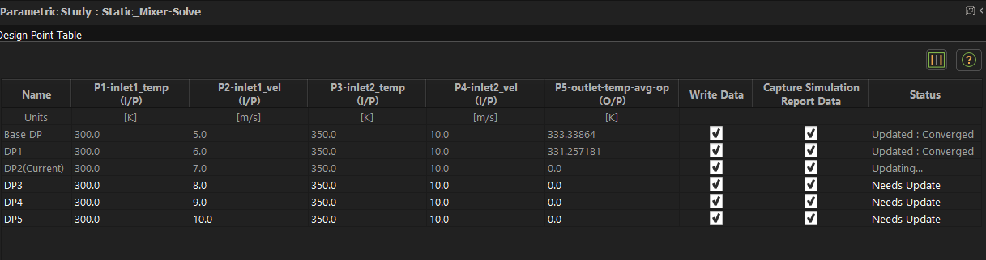
Updating Design Point Solutions
As the calculations for each design point progresses, information is printed to the console and the Status column in the Design Point Table updates accordingly.

Slide 12
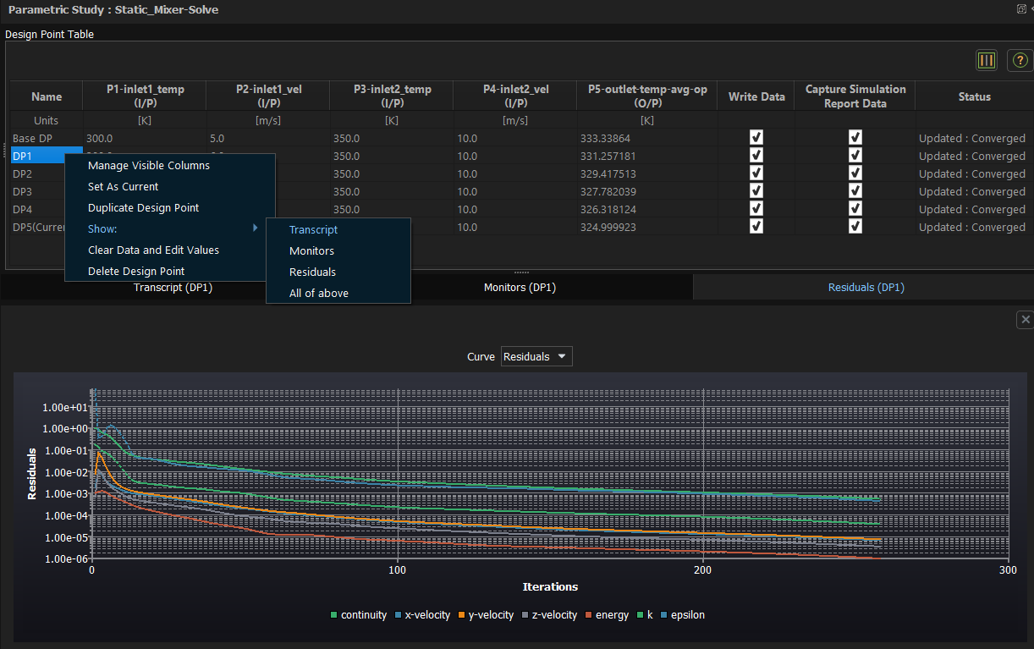
Updating Design Point Solutionsitions
Select and view either of these metrics > (Transcripts , Monitors, Residuals) for any Data point under study.

Slide 13
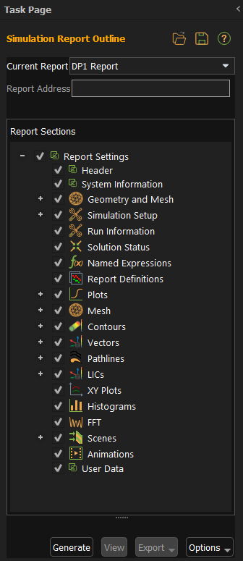
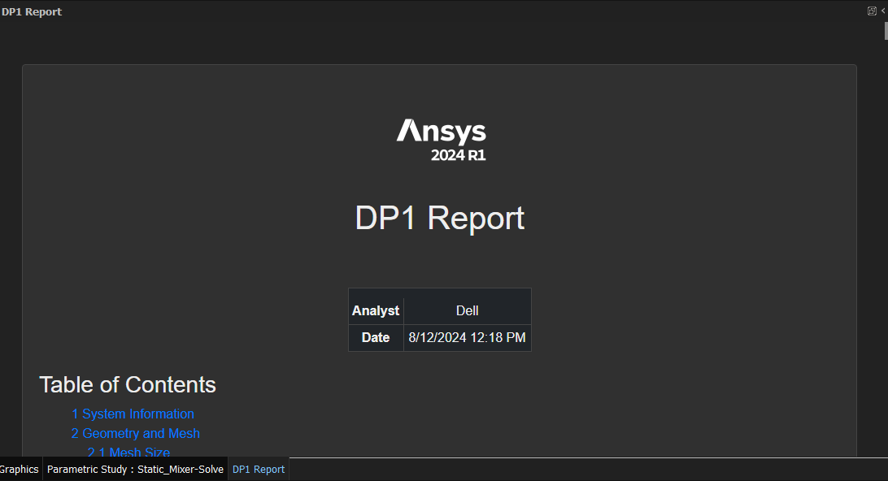
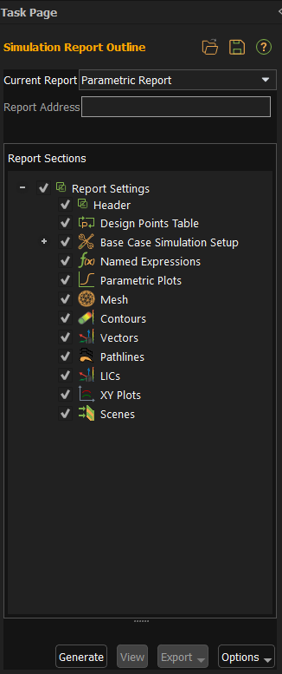
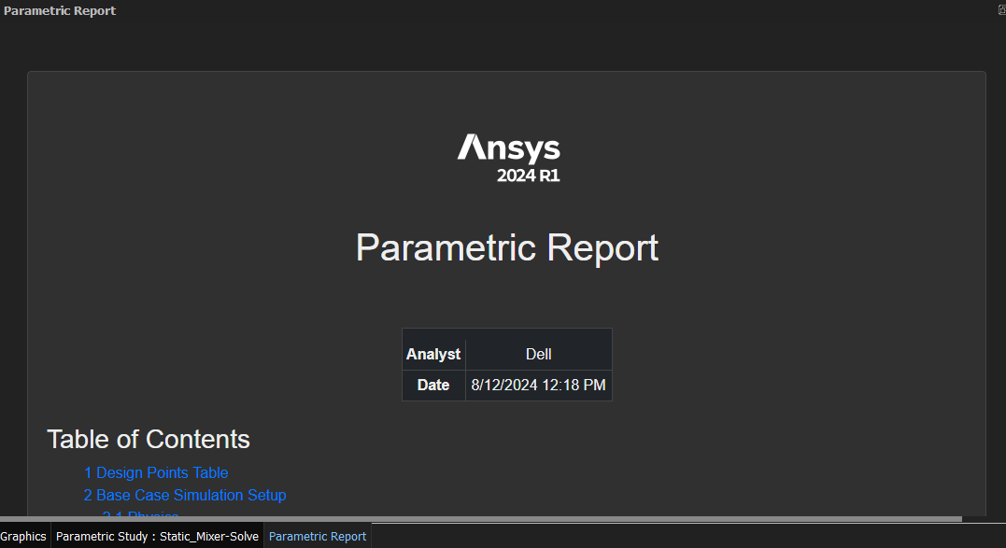
Generate Design Point and Parametric Report

Slide 14
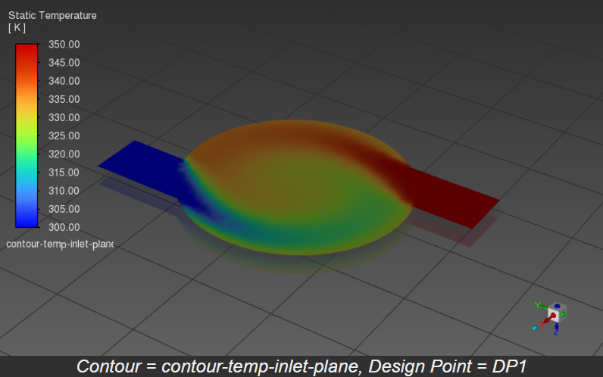
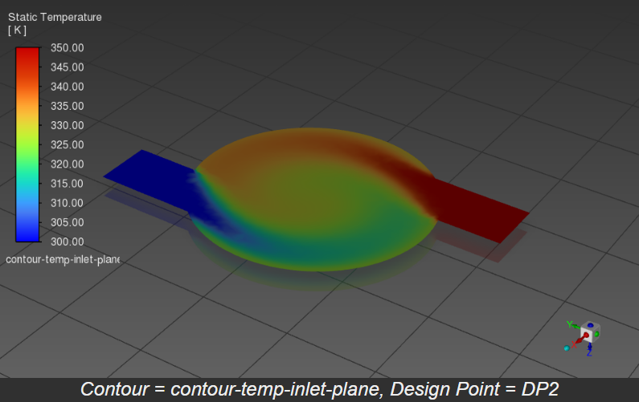
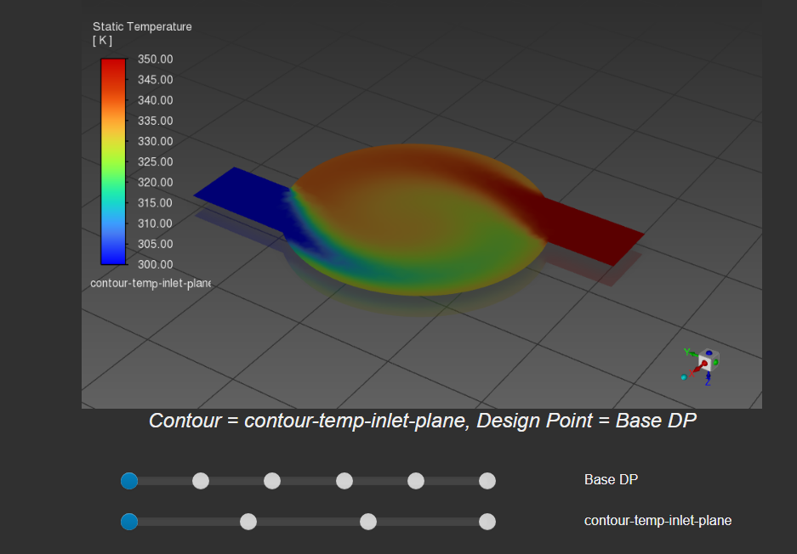
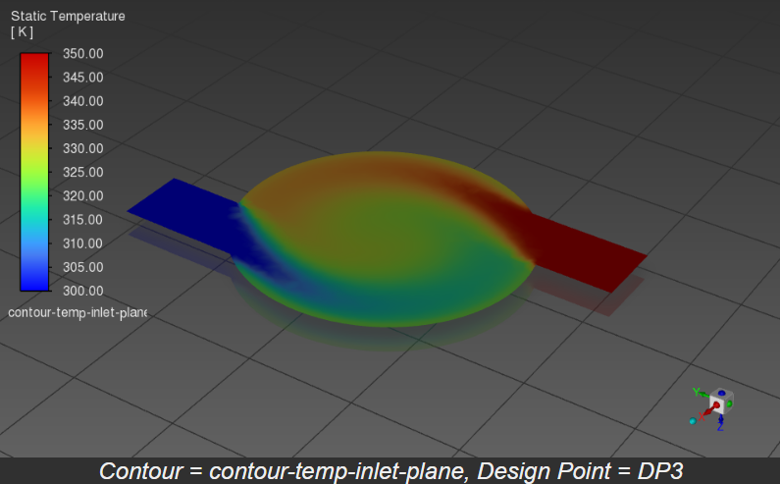
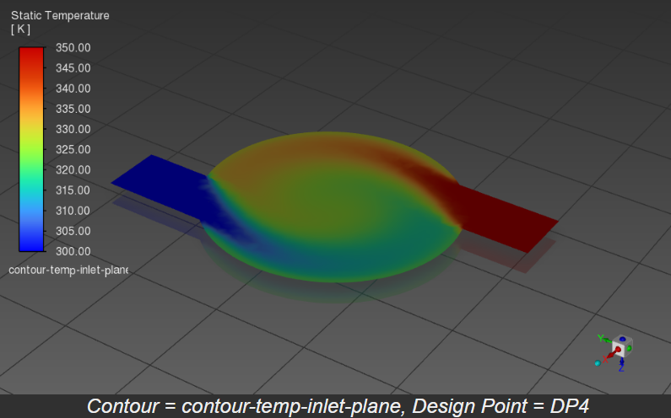
Compare Design Point Results
Open parametric Reports > Contours section
Slide the slider to see results at different design points

Slide 15
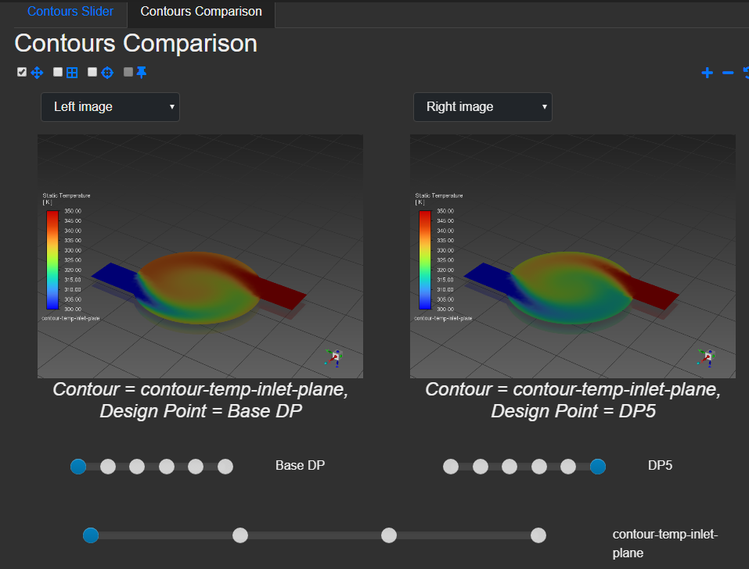
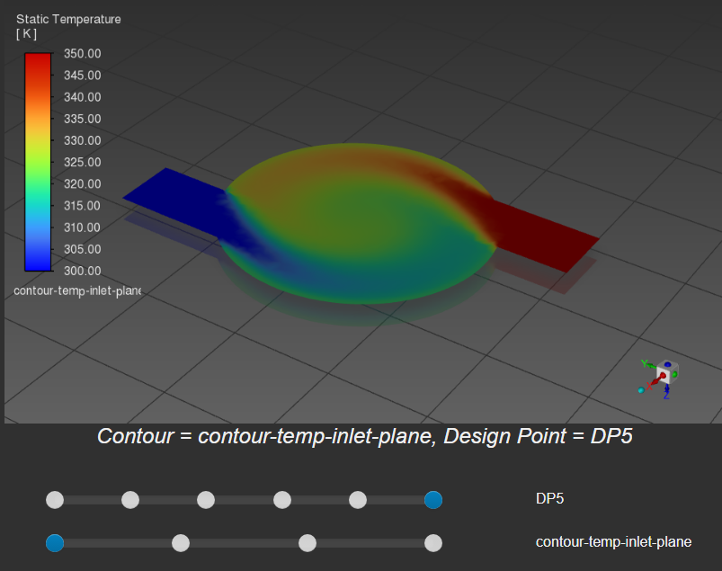
Compare Design Point Results
Open parametric Reports > Contours section
Select Comparison Contours to compare two different design points

Slide 16
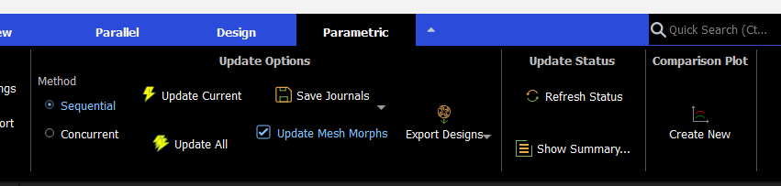
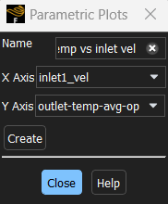
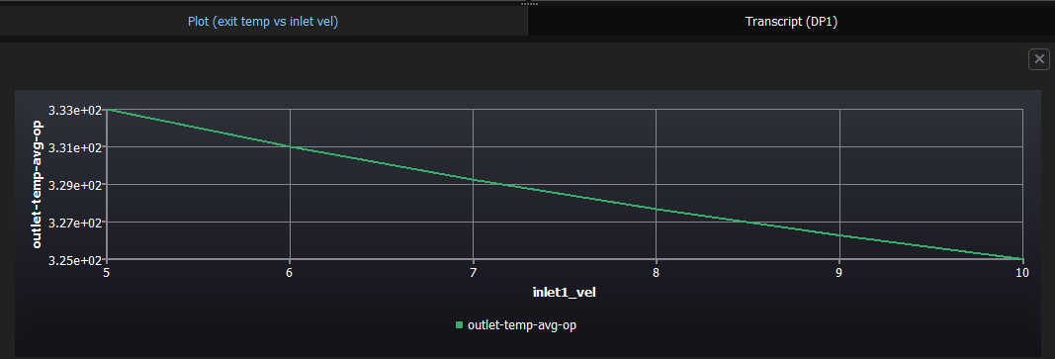
Compare Design Point Results
Select Comparison plots to plot input and outputs variables as they vary with each other

